Slide 1

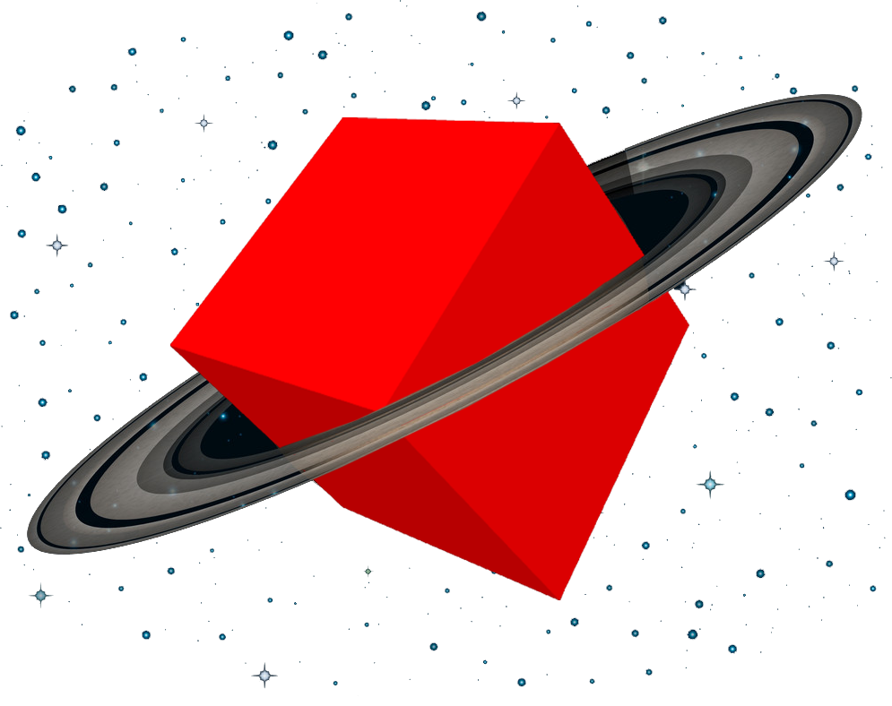
OUR NEXT STOP: WEB-AR
AUGMENTED REALITY FOR YOUR MOBILE BROWSER
ANASTASIIA MIROSHNICHENKO
WEB XR DEVELOPER AT SAINT ELMO‘S BERLIN
Notes:
The world of technology is moving very fast. You have heard that AR is said to be the next big thing – and yet we already have a new topic popping up: Web-AR: the power of AR without the need for an Application.

Slide 2
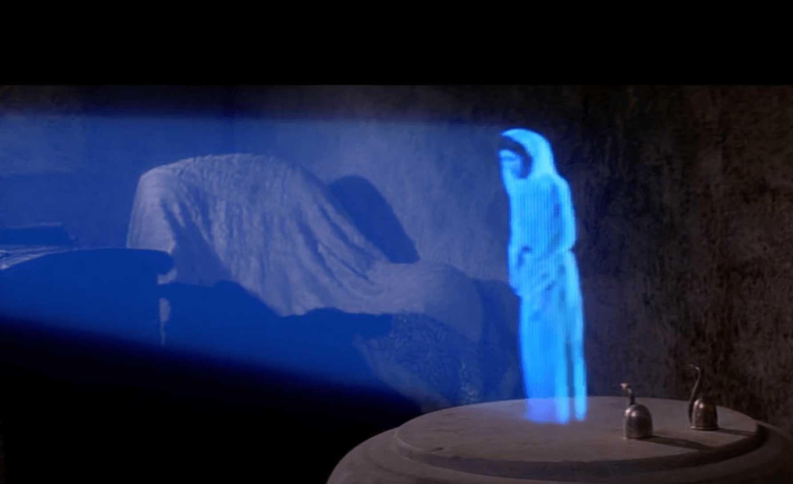
REMEMBER WHEN
THIS SEEMED LIKE
A FAR AWAY FUTURE?
Source: Disney/LucasFilm
Notes:
Do you remember when this seemed like a far far away future? ..
The idea of holographic communication has very much been shaped by Holylwood. Princess Leia in Star Wars in 1999.
So whenever we see Holograms it appears to us like we see the future.

Slide 3
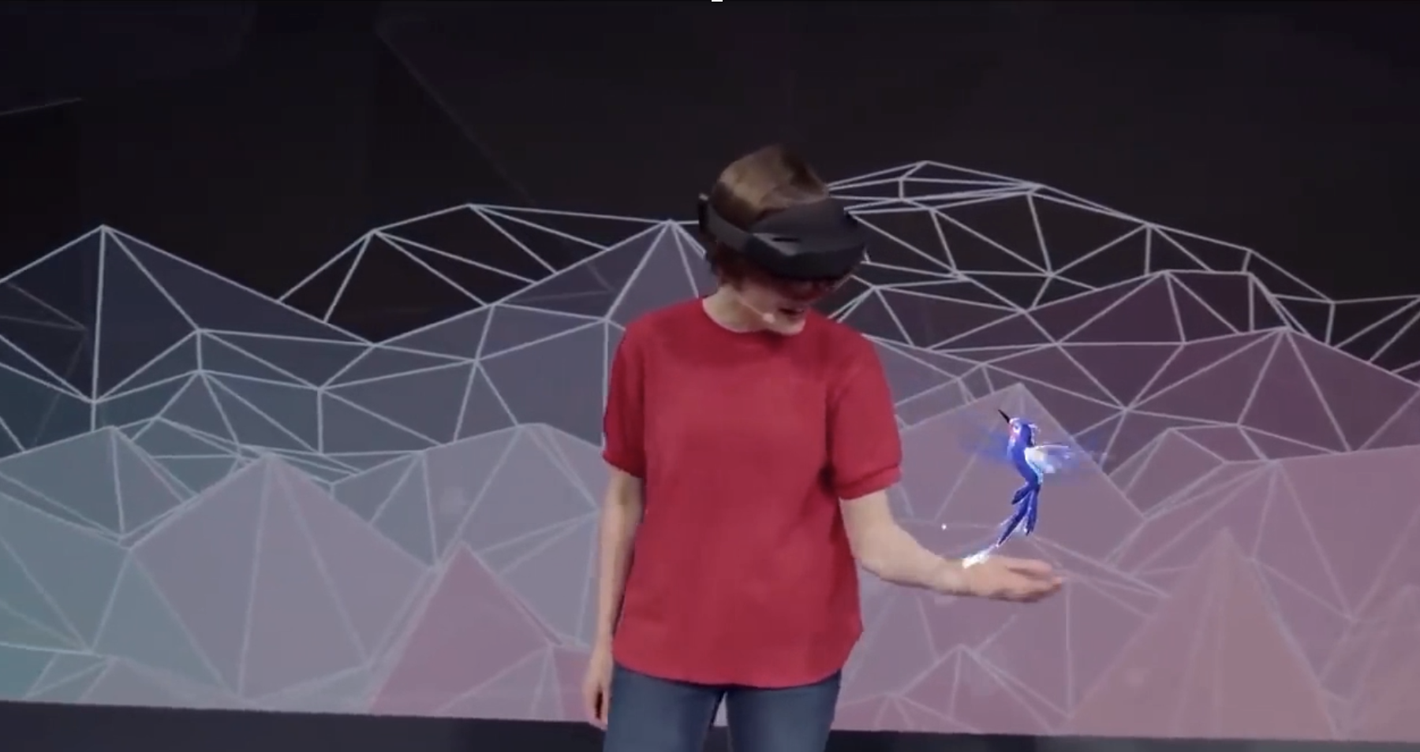
THE FUTURE
IS NOW.
Source: Microsoft
Notes:
But the future is now, we have caught up with Hollywood.
Emerging technologies offer us completely new possibilities: Holographic Tools and Experiences will change the way we communicate.

Slide 4
WE CAME A LONG WAY.
Notes:
We came a long way.

Slide 5
SENSORAMA
MORTON HEILIG, 1962
Notes:
Already in 1962 people were driven by the idea to make immersive experiences that would transport you to different places. The Sensorama – an arcade-like machine was one of the first examples that should make you sense different scenarios.
Looks pretty much like what we nowadays can experience with VR-Headsets.
Sensorama, the world’s first virtual reality device. That is one of the earliest known examples of immersive, multi-sensory technology, which was introduced in 1962 by Morton Heilig.
The Sensorama was a mechanical device, which includes a stereoscopic color display, fans, odor emitters, stereo‐sound system, and a motional chair. It simulated a motorcycle ride through New York and created the experience by having the spectator sit in an imaginary motorcycle while experiencing the street through the screen, fan-generated wind, and the simulated noise and smell of the city.

Slide 6
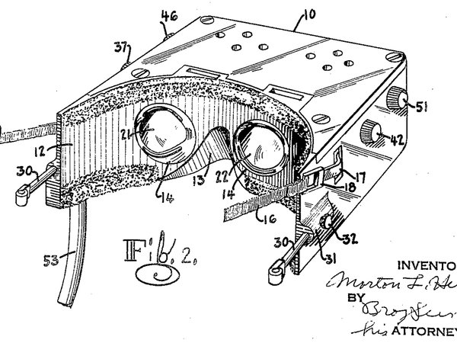
FIRST VR PATENT
MORTON HEILIG, 1960
Notes:
The same guy registered a patent for a device that pretty much resembled what we know today as a VR-Headset.
Did you know that – funny isn’t it?
In the 1950s, Morton Heilig also was designing a portable VR HMD. According to the specs, this device, which looks remarkably similar to modern day HMDs, would use lenses with 140 degree horizontal and vertical view angles. It also included stereo earphones, and an air discharge nozzle to emulate the feeling of wind against your face. Similar to the Sensorama, it also would be able to use a number of perfumes to simulate different environments.

Slide 7
FIRST VR HEAD MOUNTED DISPLAY
IVAN SUTHERLAND, 1968
Notes:
The first functional (VR) head-mounted display (HMD) system was created in 1968 by computer scientist Ivan Sutherland.

Slide 8
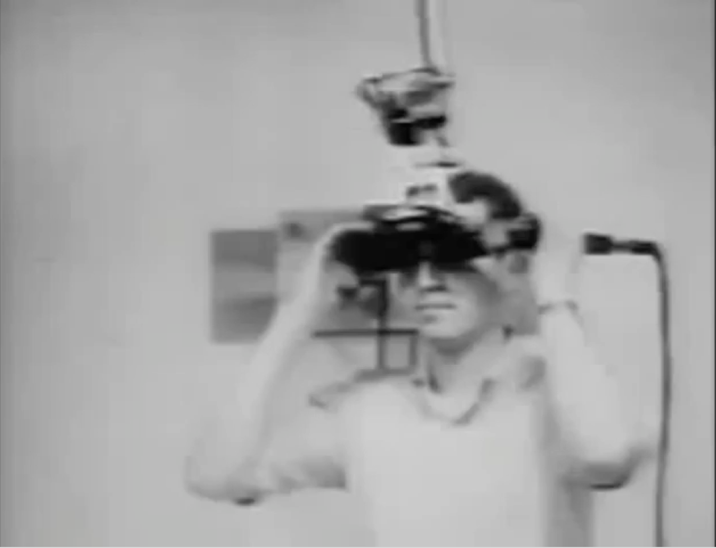
Source: YouTube, Giulio Di Vico
Notes:
A very large device using the power of cathode ray tubes that was mounted on the ceiling. It projected a virtual object in front of the user.
Due to the bulky and heavy set-up it was called the “Sword of Damocles”.
The unit used two cathode ray tubes (one for each eye) and optical elements to project computer generated images into the operator's eyes. The selected optical elements allowed users to see 3D images superimposed over real life objects, making this more of an augmented reality headset, in truth. The initial prototype device was so overwhelmingly bulky and heavy that the researchers needed to mount it on an arm from the ceiling to use it. This version was nicknamed "The Sword Of Damocles."
All this has changed dramatically. Holographic communication is not that complicated anymore. No more need to carry bulky devices. It’s easier accessible than you might think, friends…
Now you might think, that AR is too complicated, not easily accessible and it seems to be useless. Rest easy, friends.

Slide 9
TODAY YOU HOLD THE FUTURE IN YOUR HAND.
Notes:
How many of you have your smartphones in your hands right now?
That’s it. You hold the future in your hands!
So take a seat, fasten your seat belts, I invite you to the very exciting trip into the world of Augmented Reality for your mobile browser - WebAR!

Slide 10
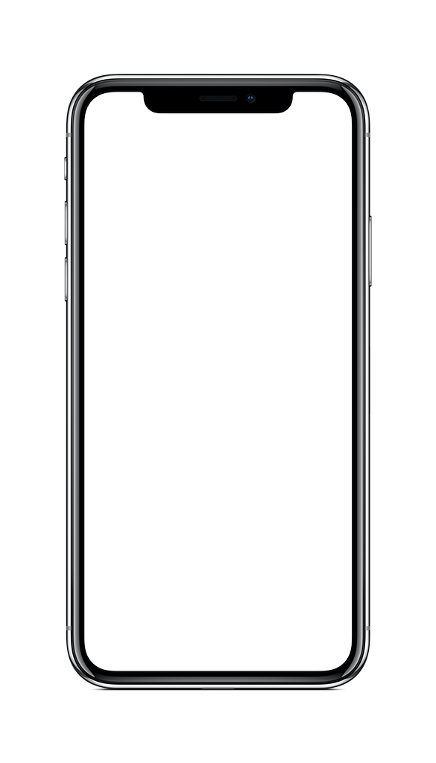
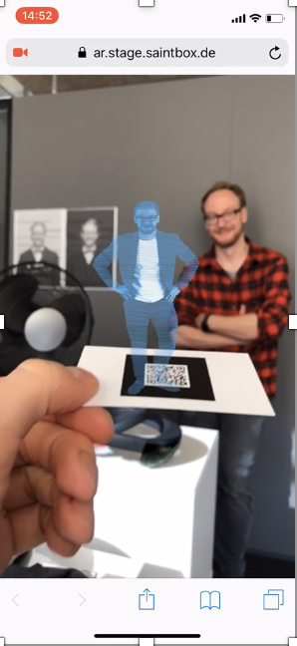
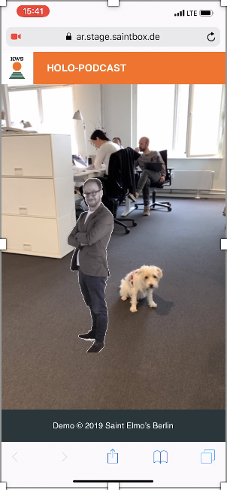
WITH MARKER
MARKERLESS
Source: Saint Elmo‘s Berlin
Notes:
Augmented Reality means to superimpose your vision of your environment with a virtual layer of information. (think of Pokemon Go, right?)
Web-AR is exactly the same – but without the need of dedicated applications. It runs in your mobile browser.
Mobile devices are able to create AR-Experiences using the cameras, motion, and orientation-sensors.
Look, we can create holograms on businesscards (meet me later to see mine, this is my boss) using markers – or we can create ar-experiences in space without markers.

Slide 11
where to start? where to go?
Notes:
Where to start and where to go?
All you need to know - basics of HTML and a bit of JavaScript. Now, this will sound familiar, right?
First, we need to find out how to create a 3D world in our web environment. Luckily, someone already did it for us.

Slide 12


Notes:
The Web Graphics Library is a Javascript API for rendering interactive 2D and 3D graphics within any compatible web browser - without the use of additional plugins. It is based on OpenGL and uses the HTML5 canvas element.

Slide 13
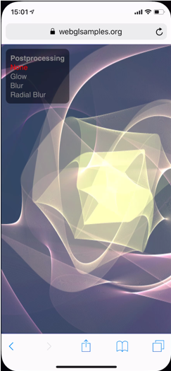
Electric flower
webgl
Source: webglsamples.org
Notes:
Because of The low-level nature of the WebGL API, there has been a rapid emergence of game engines, like Unreal Engine or Unity, and a list of libraries that provide many high-level features, such as A-Frame from Mozilla, BabylonJS, PlayCanvas, ThreeJS, and many others.

Slide 14
three.js
Notes:
I want to start with Three.js.
Three.js is a cross-browser JavaScript library that helps us to get 3D computer graphic content to mobile browsers.
The core of this library is WebGL renderer to JavaScript, making it possible to render complex 3D content over the browser.
Let’s try to set up Three.js in our local environment. And I will show you how to do that!

Slide 15
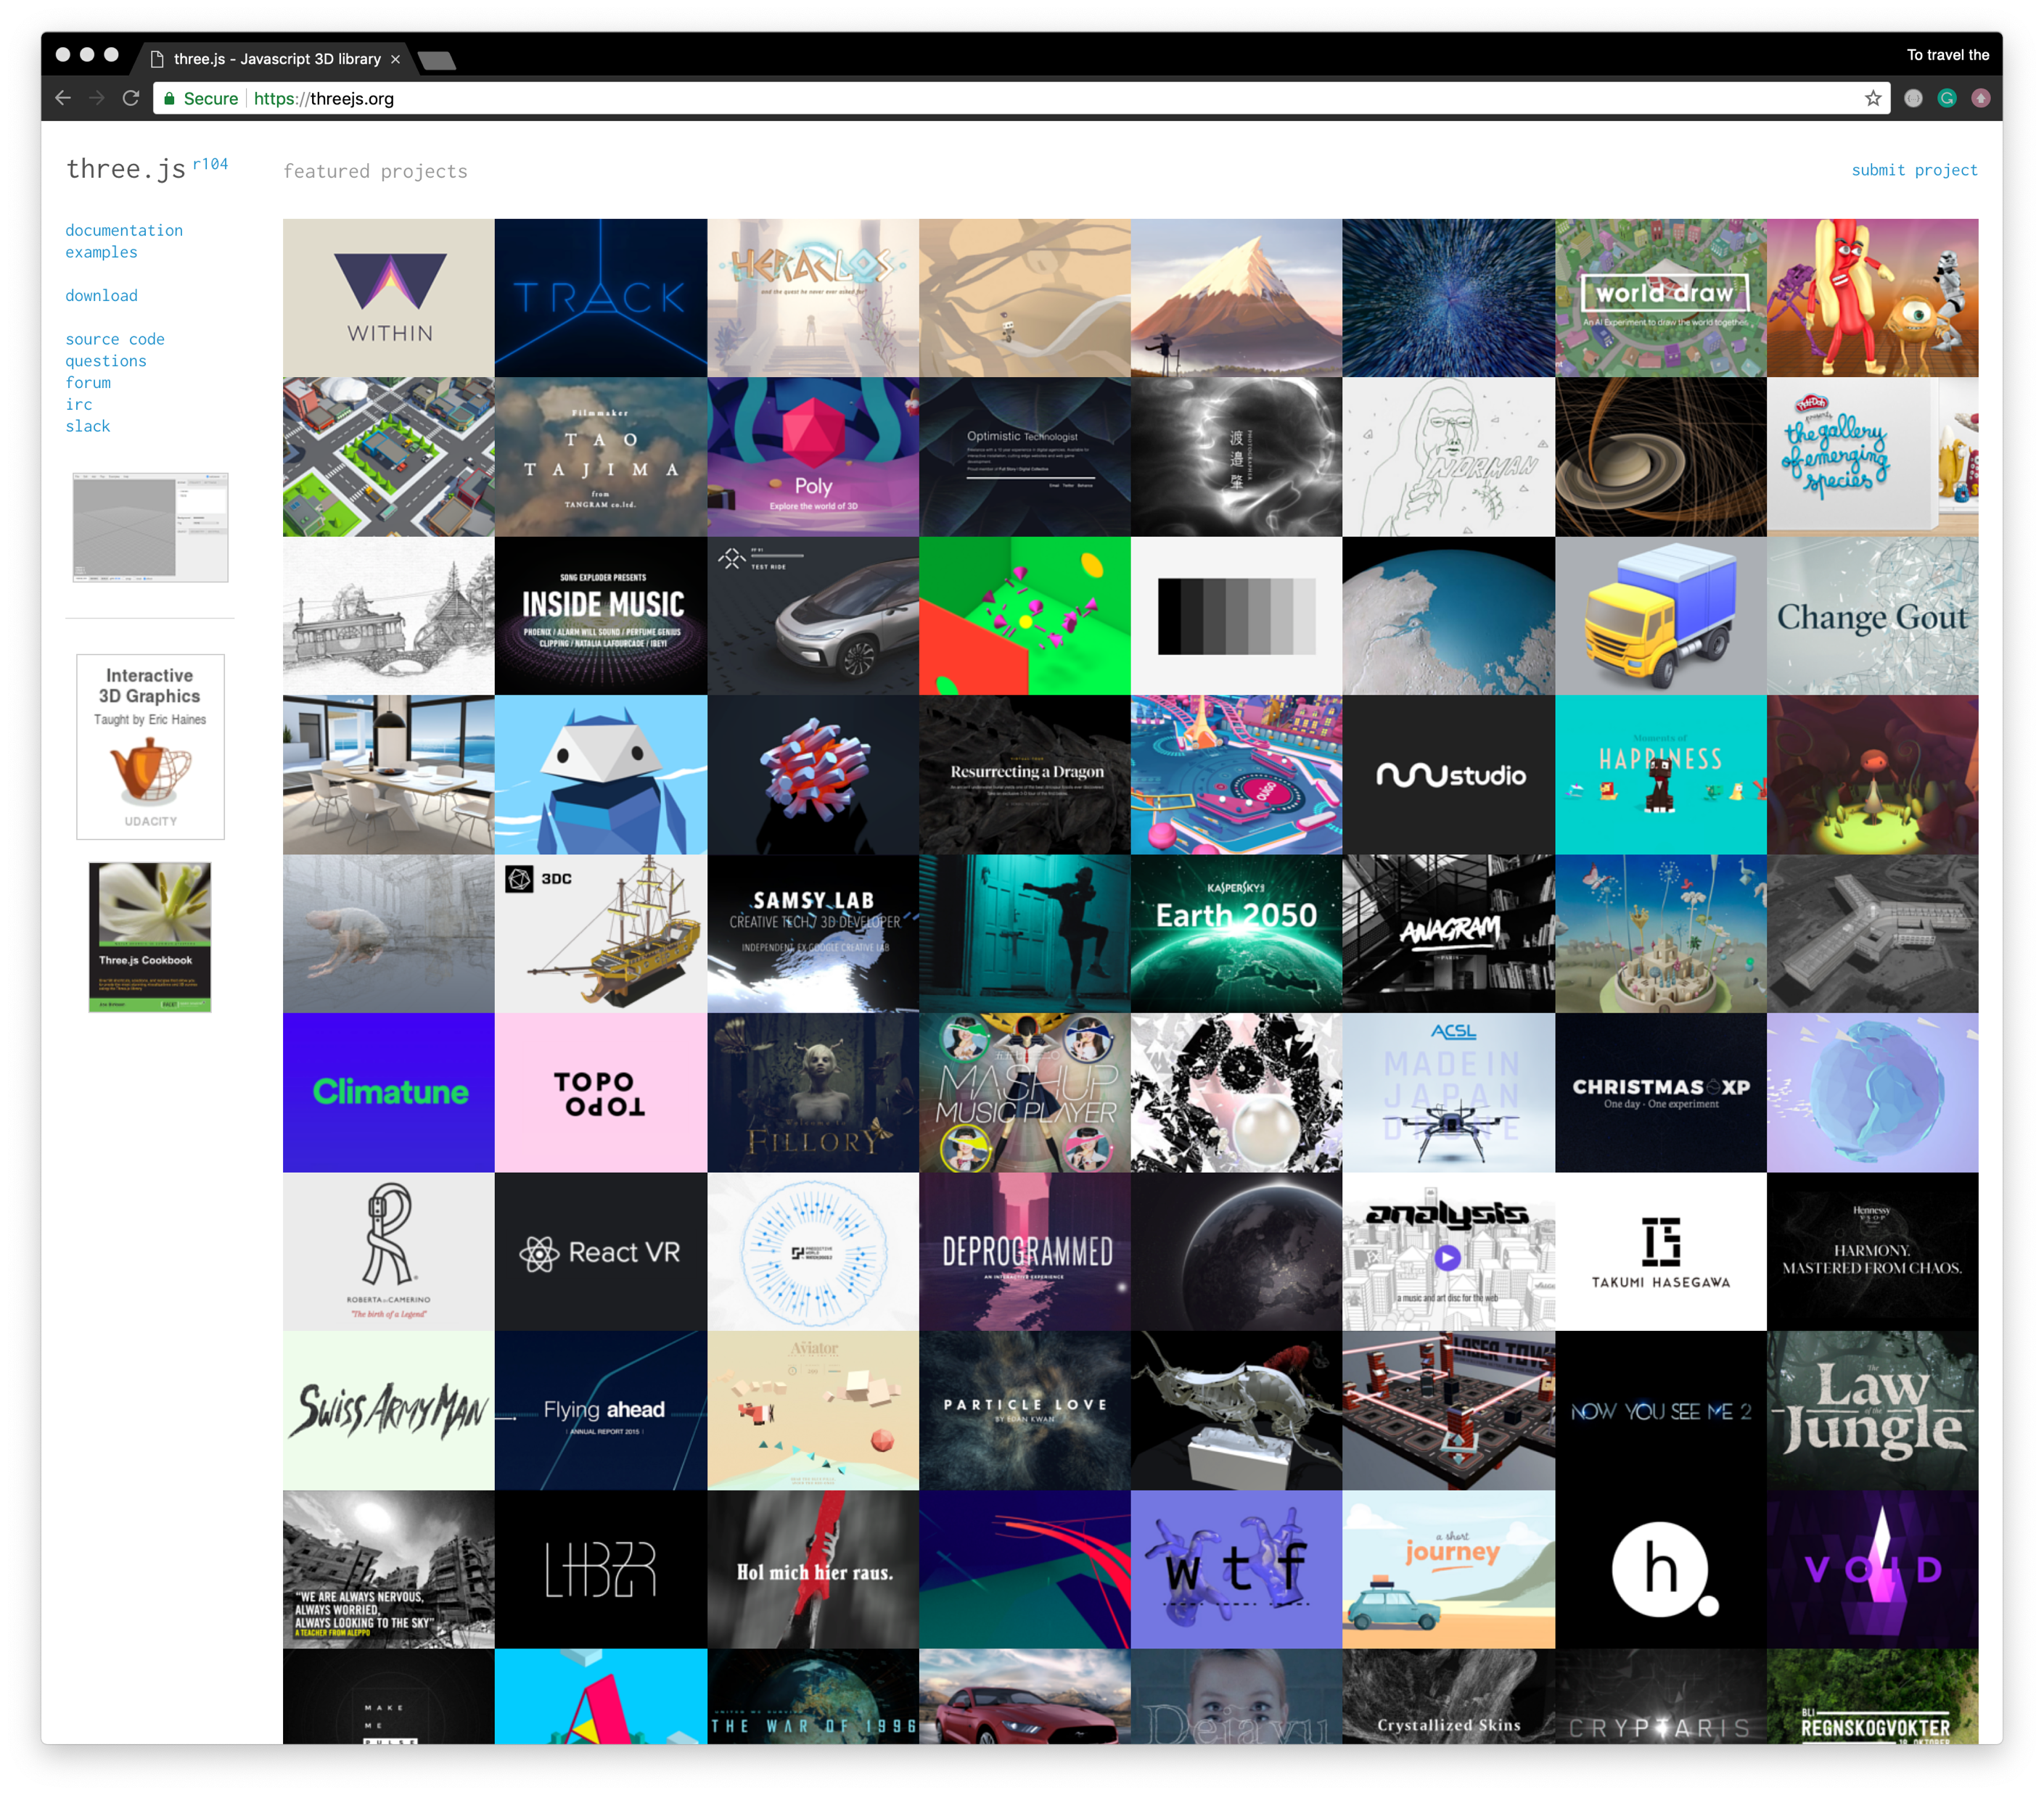
Notes:
Well, it’s pretty simple. All you have to do is go to threejs.org and download the latest version of the library and store it in your project folder.
Nice thing about this, you just need to include a CDN-link and all the project data is included in your project.

Slide 16
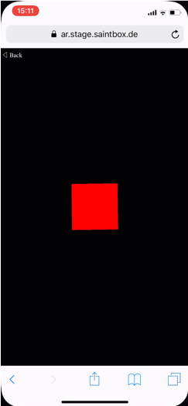
Red cube
Three.js
Source: Saint Elmo‘s Berlin
Notes:
We will start by setting up a scene, with a spinning red cube.

Slide 17
<!DOCTYPE html> <html> <head> <title>Our next stop: WebAR</title>
<script src="https://cdnjs.cloudflare.com/ajax/libs/three.js/104/three.js"></script> </head> <body> <script> /* Our Javascript code will go here */
</script> </body> </html>
Notes:
Let’s dive into HTML:
Here you can see the basic HTML setup and that’s all!
All the code will go into the empty <script> Tag.

Slide 18
<!DOCTYPE html> <html> <head> <title>Our next stop: WebAR</title> <script src="https://cdnjs.cloudflare.com/ajax/libs/three.js/104/three.js"></script> </head> <body> <script>
</script> </body> </html>
Notes:
Actually, to be able to display anything with three.js, we need three things:

Slide 19
<!DOCTYPE html> <html> <head> <title>Our next stop: WebAR</title> <script src="https://cdnjs.cloudflare.com/ajax/libs/three.js/104/three.js"></script> </head> <body> <script> var scene = new THREE.Scene();
</script> </body> </html>
Notes:
scene

Slide 20
<!DOCTYPE html> <html> <head> <title>Our next stop: WebAR</title> <script src="https://cdnjs.cloudflare.com/ajax/libs/three.js/104/three.js"></script> </head> <body> <script> var scene = new THREE.Scene(); var camera = new THREE.PerspectiveCamera( 75, window.innerWidth/window.innerHeight, 0.1, 1000 );
</script> </body> </html>
Notes:
camera

Slide 21
<!DOCTYPE html> <html> <head> <title>Our next stop: WebAR</title> <script src="https://cdnjs.cloudflare.com/ajax/libs/three.js/104/three.js"></script> </head> <body> <script> var scene = new THREE.Scene(); var camera = new THREE.PerspectiveCamera( 75, window.innerWidth/window.innerHeight, 0.1, 1000 ); var renderer = new THREE.WebGLRenderer(); renderer.setSize( window.innerWidth, window.innerHeight ); document.body.appendChild( renderer.domElement );
renderer.render( scene, camera );
</script> </body> </html>
Notes:
Actually, to be able to display anything with three.js, we need three things: scene, camera, and renderer, so that we are able to render the scene with the camera.

Slide 22
<!DOCTYPE html> <html> <head> <title>Our next stop: WebAR</title> <script src="https://cdnjs.cloudflare.com/ajax/libs/three.js/104/three.js"></script> </head> <body> <script> var scene = new THREE.Scene(); var camera = new THREE.PerspectiveCamera( 75, window.innerWidth/window.innerHeight, 0.1, 1000 ); var renderer = new THREE.WebGLRenderer(); renderer.setSize( window.innerWidth, window.innerHeight ); document.body.appendChild( renderer.domElement );
renderer.render( scene, camera );
</script> </body> </html>
Notes:
There are a few different cameras in three.js. We will use the most common one --- a PerspectiveCamera. It requires some parameters.

Slide 23
<!DOCTYPE html> <html> <head> <title>Our next stop: WebAR</title> <script src="https://cdnjs.cloudflare.com/ajax/libs/three.js/104/three.js"></script> </head> <body> <script> var scene = new THREE.Scene(); var camera = new THREE.PerspectiveCamera( 75, window.innerWidth/window.innerHeight, 0.1, 1000 ); var renderer = new THREE.WebGLRenderer(); renderer.setSize( window.innerWidth, window.innerHeight ); document.body.appendChild( renderer.domElement );
renderer.render( scene, camera );
</script> </body> </html>
Notes:
FOV (Field of View) is the extent of the scene that is seen on the display at any given moment. The value is in degrees.

Slide 24
<!DOCTYPE html> <html> <head> <title>Our next stop: WebAR</title> <script src="https://cdnjs.cloudflare.com/ajax/libs/three.js/104/three.js"></script> </head> <body> <script> var scene = new THREE.Scene(); var camera = new THREE.PerspectiveCamera( 75, window.innerWidth/window.innerHeight, 0.1, 1000 ); var renderer = new THREE.WebGLRenderer(); renderer.setSize( window.innerWidth, window.innerHeight ); document.body.appendChild( renderer.domElement );
renderer.render( scene, camera );
</script> </body> </html>
Notes:
The second one is an aspect ratio. You almost always want to use the width of the element divided by the height.

Slide 25
<!DOCTYPE html> <html> <head> <title>Our next stop: WebAR</title> <script src="https://cdnjs.cloudflare.com/ajax/libs/three.js/104/three.js"></script> </head> <body> <script> var scene = new THREE.Scene(); var camera = new THREE.PerspectiveCamera( 75, window.innerWidth/window.innerHeight, 0.1, 1000 ); var renderer = new THREE.WebGLRenderer(); renderer.setSize( window.innerWidth, window.innerHeight ); document.body.appendChild( renderer.domElement );
renderer.render( scene, camera );
</script> </body> </html>
Notes:
The next two attributes are the near and far clipping plane. What that means, is that objects further away from the camera than the value of far or closer than near won't be rendered. You don't have to worry about this now, you can take a look at it later by yourself.

Slide 26
<!DOCTYPE html> <html> <head> <title>Our next stop: WebAR</title> <script src="https://cdnjs.cloudflare.com/ajax/libs/three.js/104/three.js"></script> </head> <body> <script> var scene = new THREE.Scene(); var camera = new THREE.PerspectiveCamera( 75, window.innerWidth/window.innerHeight, 0.1, 1000 ); var renderer = new THREE.WebGLRenderer(); renderer.setSize( window.innerWidth, window.innerHeight ); document.body.appendChild( renderer.domElement );
renderer.render( scene, camera );
</script> </body> </html>
Notes:
Next up is the renderer. This is where the magic happens.

Slide 27
<!DOCTYPE html> <html> <head> <title>Our next stop: WebAR</title> <script src="https://cdnjs.cloudflare.com/ajax/libs/three.js/104/three.js"></script> </head> <body> <script> var scene = new THREE.Scene(); var camera = new THREE.PerspectiveCamera( 75, window.innerWidth/window.innerHeight, 0.1, 1000 ); var renderer = new THREE.WebGLRenderer(); renderer.setSize( window.innerWidth, window.innerHeight ); document.body.appendChild( renderer.domElement );
renderer.render( scene, camera );
</script> </body> </html>
Notes:
In addition to creating the renderer instance, we also need to set the size at which we want to render our app.

Slide 28
<!DOCTYPE html> <html> <head> <title>Our next stop: WebAR</title> <script src="https://cdnjs.cloudflare.com/ajax/libs/three.js/104/three.js"></script> </head> <body> <script> var scene = new THREE.Scene(); var camera = new THREE.PerspectiveCamera( 75, window.innerWidth/window.innerHeight, 0.1, 1000 ); var renderer = new THREE.WebGLRenderer(); renderer.setSize( window.innerWidth, window.innerHeight ); document.body.appendChild( renderer.domElement );
renderer.render( scene, camera );
</script> </body> </html>
Notes:
Last but not least, we are adding the renderer element to our HTML document. This is an <canvas> element the renderer uses to display the scene to us.

Slide 29
<!DOCTYPE html> <html> <head> <title>Our next stop: WebAR</title> <script src="https://cdnjs.cloudflare.com/ajax/libs/three.js/104/three.js"></script> </head> <body> <script> var scene = new THREE.Scene(); var camera = new THREE.PerspectiveCamera( 75, window.innerWidth/window.innerHeight, 0.1, 1000 ); var renderer = new THREE.WebGLRenderer(); renderer.setSize( window.innerWidth, window.innerHeight ); document.body.appendChild( renderer.domElement );
renderer.render( scene, camera );
</script> </body> </html>

Slide 30
<script> var scene = new THREE.Scene(); var camera = new THREE.PerspectiveCamera( 75, window.innerWidth/window.innerHeight, 0.1, 1000 ); var renderer = new THREE.WebGLRenderer(); renderer.setSize( window.innerWidth, window.innerHeight ); document.body.appendChild( renderer.domElement );
renderer.render( scene, camera );
</script>
Notes:
Now, when the “Basement” is ready we will create our Red Cube.
Let’s take a look.

Slide 31
<script> var scene = new THREE.Scene(); var camera = new THREE.PerspectiveCamera( 75, window.innerWidth/window.innerHeight, 0.1, 1000 ); var renderer = new THREE.WebGLRenderer(); renderer.setSize( window.innerWidth, window.innerHeight ); document.body.appendChild( renderer.domElement );
var geometry = new THREE.BoxGeometry( 1, 1, 1 );
renderer.render( scene, camera );
</script>
Notes:
To create a cube, we need BoxGeometry. This is an object that contains all the points (vertices) and faces of the cube. There are a lot of other geometries, just go to the website to explore them.

Slide 32
<script> var scene = new THREE.Scene(); var camera = new THREE.PerspectiveCamera( 75, window.innerWidth/window.innerHeight, 0.1, 1000 ); var renderer = new THREE.WebGLRenderer(); renderer.setSize( window.innerWidth, window.innerHeight ); document.body.appendChild( renderer.domElement );
var geometry = new THREE.BoxGeometry( 1, 1, 1 ); var material = new THREE.MeshBasicMaterial( { color: 0xff0000 } );
renderer.render( scene, camera );
</script>
Notes:
In addition to the BoxGeometry, we need material to color it. Three.js comes with several materials, but we'll stick to the MeshBasicMaterial for now. To keep things very simple, we only apply a color attribute of 0xFF0000, which is red. This works the same way that colors work in CSS or Photoshop (hex colors).

Slide 33
<script> var scene = new THREE.Scene(); var camera = new THREE.PerspectiveCamera( 75, window.innerWidth/window.innerHeight, 0.1, 1000 ); var renderer = new THREE.WebGLRenderer(); renderer.setSize( window.innerWidth, window.innerHeight ); document.body.appendChild( renderer.domElement );
var geometry = new THREE.BoxGeometry( 1, 1, 1 ); var material = new THREE.MeshBasicMaterial( { color: 0xff0000 } ); var cube = new THREE.Mesh( geometry, material );
renderer.render( scene, camera );
</script>
Notes:
The third thing we need is a Mesh. A mesh is an object that takes geometry and applies a material to it, which we then can insert to our scene.

Slide 34
<script> var scene = new THREE.Scene(); var camera = new THREE.PerspectiveCamera( 75, window.innerWidth/window.innerHeight, 0.1, 1000 ); var renderer = new THREE.WebGLRenderer(); renderer.setSize( window.innerWidth, window.innerHeight ); document.body.appendChild( renderer.domElement );
var geometry = new THREE.BoxGeometry( 1, 1, 1 ); var material = new THREE.MeshBasicMaterial( { color: 0xff0000 } ); var cube = new THREE.Mesh( geometry, material ); scene.add( cube );
renderer.render( scene, camera );
</script>
Notes:
By default, when we call scene.add(), the thing we add will be added to the coordinates (0,0,0). This would cause both the camera and the cube to be inside each other.

Slide 35
<script> var scene = new THREE.Scene(); var camera = new THREE.PerspectiveCamera( 75, window.innerWidth/window.innerHeight, 0.1, 1000 ); var renderer = new THREE.WebGLRenderer(); renderer.setSize( window.innerWidth, window.innerHeight ); document.body.appendChild( renderer.domElement );
var geometry = new THREE.BoxGeometry( 1, 1, 1 ); var material = new THREE.MeshBasicMaterial( { color: 0xff0000 } ); var cube = new THREE.Mesh( geometry, material ); scene.add( cube ); camera.position.z = 5;
renderer.render( scene, camera );
</script>
Notes:
To avoid this, we simply move the camera out a bit.

Slide 36
<script> var scene = new THREE.Scene(); var camera = new THREE.PerspectiveCamera( 75, window.innerWidth/window.innerHeight, 0.1, 1000 ); var renderer = new THREE.WebGLRenderer(); renderer.setSize( window.innerWidth, window.innerHeight ); document.body.appendChild( renderer.domElement );
var geometry = new THREE.BoxGeometry( 1, 1, 1 ); var material = new THREE.MeshBasicMaterial( { color: 0xff0000 } ); var cube = new THREE.Mesh( geometry, material ); scene.add( cube ); camera.position.z = 5;
renderer.render( scene, camera );
</script>
Notes:
If you followed me and paste the code from above into your HTML file, you will be able to see our red cube. Congratulations!

Slide 37
<script> var scene = new THREE.Scene(); var camera = new THREE.PerspectiveCamera( 75, window.innerWidth/window.innerHeight, 0.1, 1000 ); var renderer = new THREE.WebGLRenderer(); renderer.setSize( window.innerWidth, window.innerHeight ); document.body.appendChild( renderer.domElement );
var geometry = new THREE.BoxGeometry( 1, 1, 1 ); var material = new THREE.MeshBasicMaterial( { color: 0xff0000 } ); var cube = new THREE.Mesh( geometry, material ); scene.add( cube ); camera.position.z = 5;
animate();
</script>
Notes:
Now, let’s animate our cube to make it more interesting by rotating it.

Slide 38
<script> var scene = new THREE.Scene(); var camera = new THREE.PerspectiveCamera( 75, window.innerWidth/window.innerHeight, 0.1, 1000 ); var renderer = new THREE.WebGLRenderer(); renderer.setSize( window.innerWidth, window.innerHeight ); document.body.appendChild( renderer.domElement );
var geometry = new THREE.BoxGeometry( 1, 1, 1 ); var material = new THREE.MeshBasicMaterial( { color: 0xff0000 } ); var cube = new THREE.Mesh( geometry, material ); scene.add( cube ); camera.position.z = 5;
function animate() { requestAnimationFrame( animate ); cube.rotation.x += 0.01; cube.rotation.y += 0.01; renderer.render( scene, camera ); } animate();
</script>
Notes:
For that, we need what's called a render- or animate-loop.
This will create a loop that causes the renderer to draw the scene every time the screen is refreshed (on a typical screen this means 60 times per second) and give the cube a nice rotation animation.

Slide 39
Red cube
Three.js
Source: Saint Elmo‘s Berlin
Notes:
This is it! We have now completed the simplest Three.js-Application! Let’s go next!
Tonthose of you how find this a bit complicated - don’t give up! There is a solution on how to make it way easier.

Slide 40
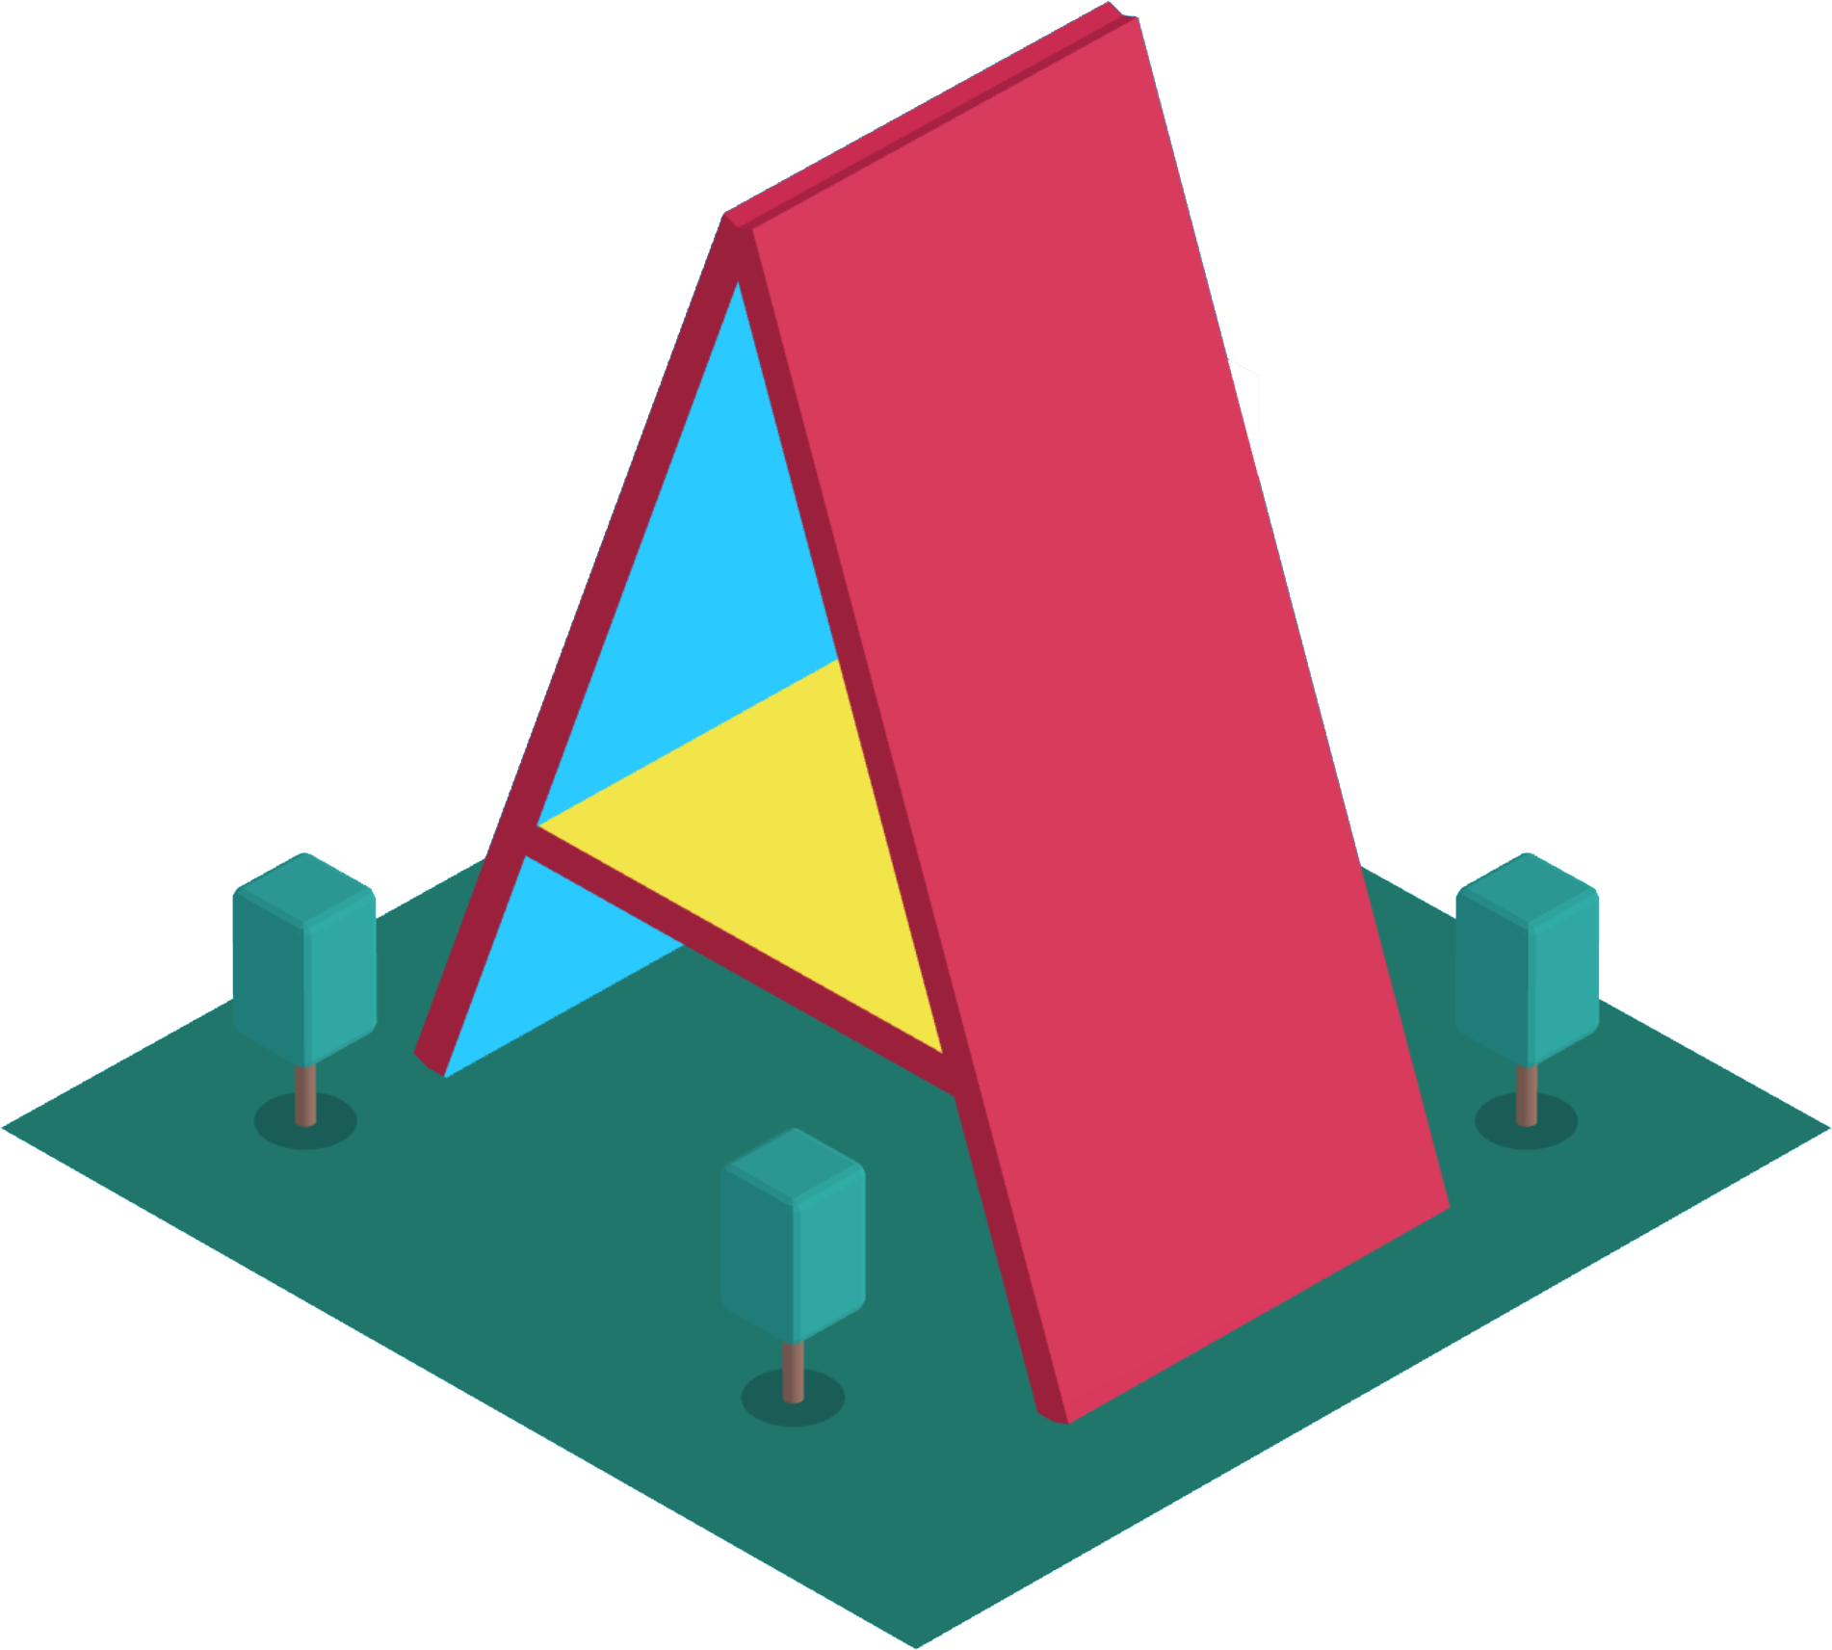
Notes:
3 years ago Mozilla developed A-Frame. It is an open-source web framework for building virtual reality experiences. A-frame is an entity component system framework for ThreeJS where developers can create 3D and WebAR scenes using HTML without having to know WebGL.
A-Frame provides primitives to create meshes, render 360 deg. content, customize the environment, place the camera, etc.

Slide 41
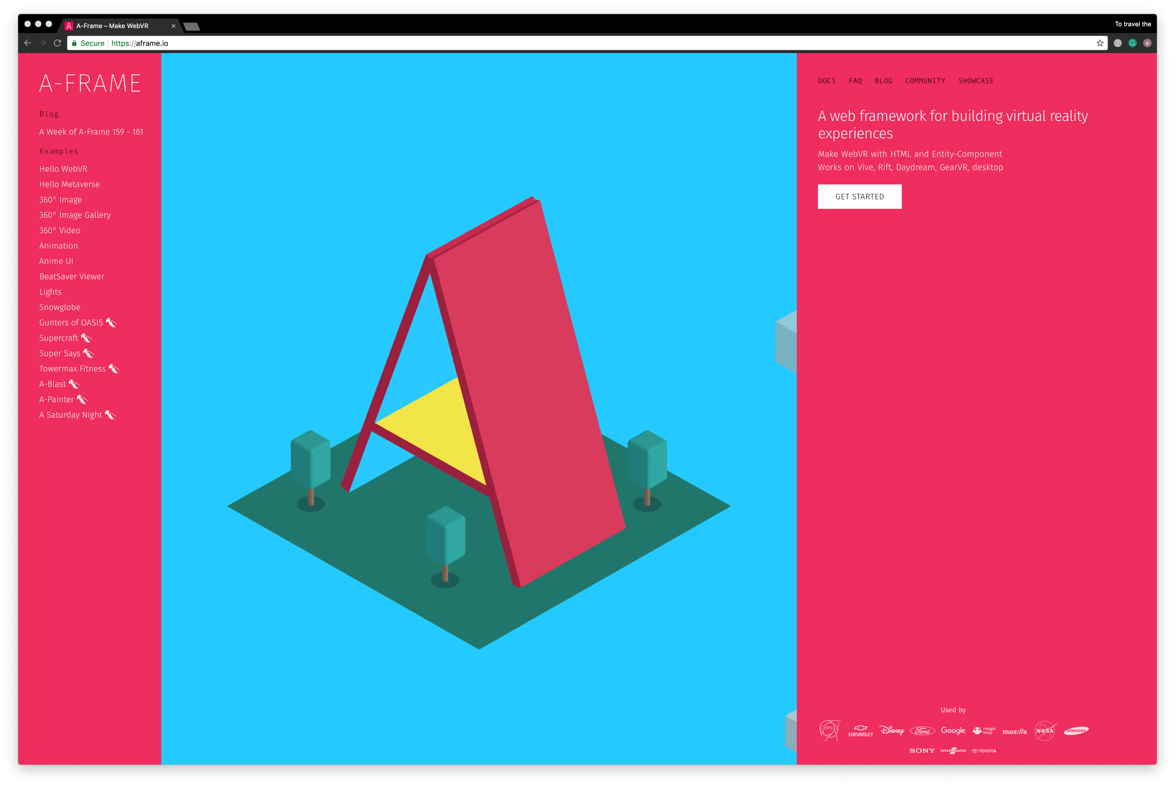
Notes:
As I said before, A-Frame can be developed with HTML without having to install anything. So making it simple to get started you need just add the A-Frame script link in the <head>.
We start by deleting everything that we wrote before..

Slide 42
<!DOCTYPE html> <html> <head> <title>Our next stop: WebAR</title> <script src="https://aframe.io/releases/0.9.1/aframe.min.js"></script> </head> <body>
<a-scene></a-scene> </body> </html>
Notes:
Let’s start by building a basic A-Frame scene.
First what we need to do, is to include <a-scene> tag in the <body>. <a-scene> will contain every entity in our scene, like it was in ThreeJS.

Slide 43
<!DOCTYPE html> <html> <head> <title>Our next stop: WebAR</title> <script src="https://aframe.io/releases/0.9.1/aframe.min.js"></script> </head> <body>
<a-scene> <a-box></a-box>
</a-scene> </body> </html>
Notes:
Within our <a-scene> tag, we attach 3D entities using one of A-Frame’s standard primitives <a-box>. We can use <a-box> tag just like a normal HTML element, defining the tag and using HTML attributes to customize it. There are also a lot of other primitives, you will find in A-Frame’s documentation.

Slide 44
<!DOCTYPE html> <html> <head> <title>Our next stop: WebAR</title> <script src="https://aframe.io/releases/0.9.1/aframe.min.js"></script> </head> <body>
<a-scene> <a-box color="red"></a-box>
</a-scene> </body> </html>
Notes:
Here we define our cube with the red color.

Slide 45
<!DOCTYPE html> <html> <head> <title>Our next stop: WebAR</title> <script src="https://aframe.io/releases/0.9.1/aframe.min.js"></script> </head> <body>
<a-scene> <a-box color="red“ position="0 1.6 -3"></a-box>
</a-scene> </body> </html>
Notes:
Again, because the default camera has a position of 0 1.6 0 and the box are positioned by default at 0 0 0, we won’t be able to see the box unless we move it. We can do this by using the position component to move our box in 3D space.

Slide 46
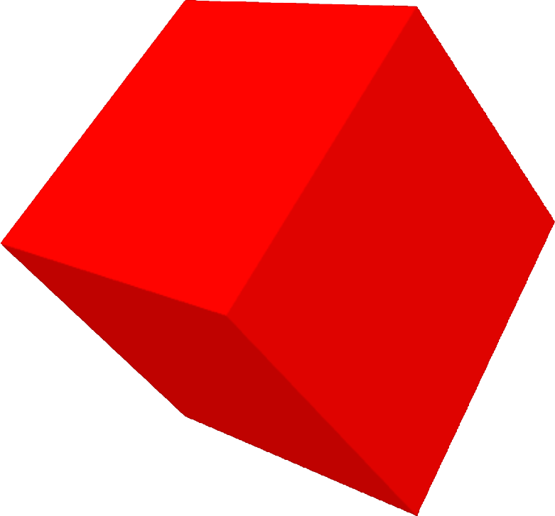
<!DOCTYPE html> <html> <head> <title>Our next stop: WebAR</title> <script src="https://aframe.io/releases/0.9.1/aframe.min.js"></script> </head> <body>
<a-scene> <a-box color="red“ position="0 1.6 -3“ rotation="0 45 45"></a-box>
</a-scene> </body> </html>
Notes:
And let’s add rotation attribute to make it look more interesting.
Now we see our box!

Slide 47
<!DOCTYPE html> <html> <head> <title>Our next stop: WebAR</title> <script src="https://aframe.io/releases/0.9.1/aframe.min.js"></script> </head> <body>
<a-scene> <a-box color="red“ position="0 1.6 -3“ rotation="0 45 45“
animation="property: rotation; to: 0 405 45; loop: true; dur: 5000"></a-box>
</a-scene> </body> </html>
Notes:
Finally, let’s add our rotation animation.

Slide 48
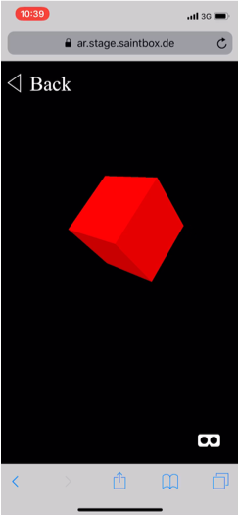
Red cube
A-frame
Source: Saint Elmo‘s Berlin
Notes:
This is how we can create the same “Red Box” experience writing only 10 lines of code! Impressive, isn’t it?

Slide 49
WHERE TO GO FROM HERE?
Notes:
Where to go from here?
Now, let’s extend our reality by placing the red cube into the real world!
There are several ways to do that.

Slide 50
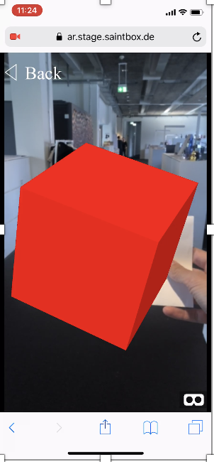
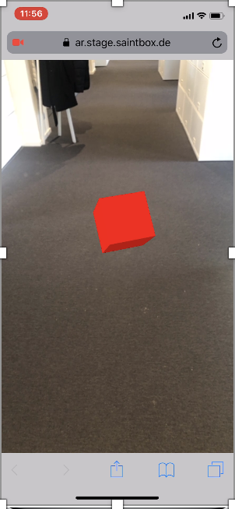
WITH MARKER
MARKERLESS
Source: Saint Elmo‘s Berlin
Notes:
First we need to ask ourselves: do we want our cube to appear directly on the marker or we want it to appear where we tap on the recognized surface?
To implement this we can use two very powerful technologies: Ar.js and 8th Wall.

Slide 51

Notes:
AR.js is the simplest way to get cross-browser Augmented Reality on the web.
It is a great project from Jerome Etienne that works on every phone browser supporting WebGL, so basically every Android phone and iPhone not older than 3 years.
How is that possible? Ar.js is marker-based technology.

Slide 52

Notes:
Markers are a sort of simplified QR-codes. On AR.js we define specific 3D scenes for specific markers, so when the camera recognizes a marker, the web-app shows the 3D object on top of it.
The default marker - is a Hiro Marker.
Hiro because of Hirokazu Kato, who developed ARToolKit in 1999.
But you can always customize the marker with a different content inside.
Let’s try this out.

Slide 53
<!DOCTYPE html> <html> <head> <title>Our next stop: WebAR</title> <script src="https://aframe.io/releases/0.9.1/aframe.min.js"></script>
</head> <body>
<a-scene>
<a-box color="red“ position="0 1.6 -3“ rotation="0 45 45“
animation="property: rotation; to: 0 405 45; loop: true; dur: 5000"></a-box>
</a-scene> </body> </html>
Notes:
We will take a setup from our last A-Frame tutorial and add a few lines of code.
You can develop it with a Three.js as well.

Slide 54
<!DOCTYPE html> <html> <head> <title>Our next stop: WebAR</title> <script src="https://aframe.io/releases/0.9.1/aframe.min.js"></script> <script src="https://cdn.rawgit.com/jeromeetienne/AR.js/1.6.2/aframe/build/aframe-ar.js"></script> </head> <body>
<a-scene>
<a-box color="red“ position="0 1.6 -3“ rotation="0 45 45“
animation="property: rotation; to: 0 405 45; loop: true; dur: 5000"></a-box>
</a-scene> </body> </html>
Notes:
First, we need to add the AR.js script to our file.

Slide 55
<!DOCTYPE html> <html> <head> <title>Our next stop: WebAR</title> <script src="https://aframe.io/releases/0.9.1/aframe.min.js"></script> <script src="https://cdn.rawgit.com/jeromeetienne/AR.js/1.6.2/aframe/build/aframe-ar.js"></script> </head> <body>
<a-scene arjs embedded>
<a-box color="red“ position="0 1.6 -3“ rotation="0 45 45“
animation="property: rotation; to: 0 405 45; loop: true; dur: 5000"></a-box>
</a-scene> </body> </html>
Notes:
Then we adding arjs and embedded attributes to the <a-scene> tag.
The embedded attribute will remove fullscreen styles from the canvas element.

Slide 56
<!DOCTYPE html> <html> <head> <title>Our next stop: WebAR</title> <script src="https://aframe.io/releases/0.9.1/aframe.min.js"></script> <script src="https://cdn.rawgit.com/jeromeetienne/AR.js/1.6.2/aframe/build/aframe-ar.js"></script> </head> <body>
<a-scene arjs embedded>
<a-marker preset="hiro"> <a-box color="red“ position="0 1.6 -3“ rotation="0 45 45“
animation="property: rotation; to: 0 405 45; loop: true; dur: 5000"></a-box>
</a-marker>
</a-scene> </body> </html>
Notes:
Finally, we need to set up our marker using the <a-marker> tag.

Slide 57
Red cube
AR.js with hiro marker
Source: webglsamples.org
Notes:
A-Frame magic!
Markers could be showed on mobile and desktop displays or printed and hanged up on walls or boards.

Slide 58

Notes:
But if you are still interested not to use Markers at all the best solution for you will be - 8th Wall Web technology, from talented guys in Palo Alto, California.

Slide 59
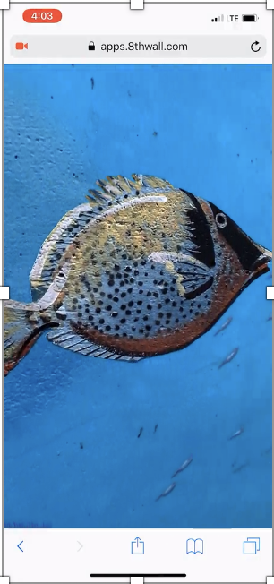
WEB-AR WITH
IMAGE-TARGETS
Source: 8th Wall Inc.
Notes:
Built entirely using standards-compliant JavaScript and WebGL, 8th Wall Web is a complete implementation of 8th Wall’s Simultaneous Localization and Mapping (SLAM) engine, hyper-optimized for real-time AR on mobile browsers. Features include 6-Degrees of Freedom Tracking, Surface Estimation, Lighting, World Points and Hit Tests.

Slide 60
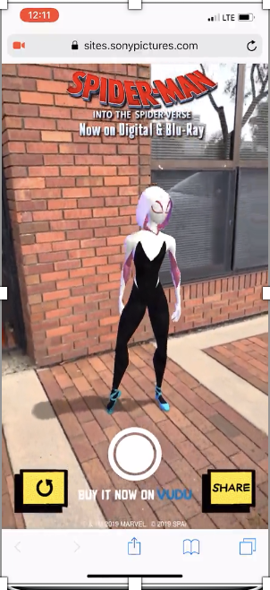
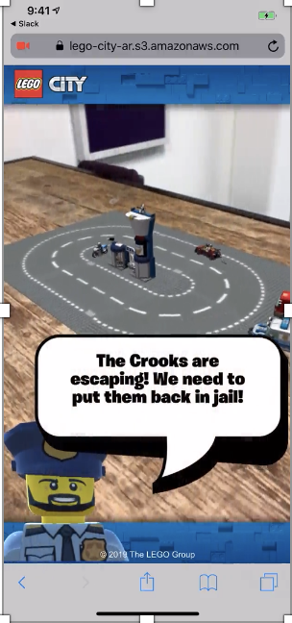
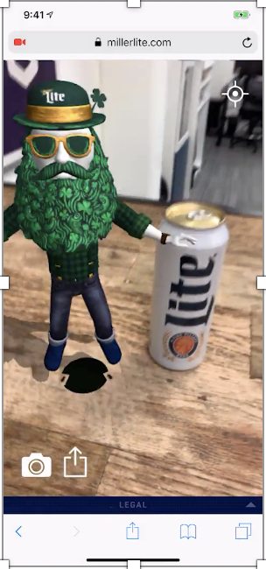
SPIDERMAN
SONY
LEGO CITY
Lego
MILLER LIGHT
MILLERCOORS
Source: 8th Wall Inc.
Notes:
8th Wall Web could be easily integrated into 3D JavaScript frameworks such as an A-Frame, Three.js, Babylon.js and Amazon Sumerian.

Slide 61

Notes:
Apple has its own approach to AR on the web.
It’s called “AR Quick-Look” and uses a file-format that was developed with Pixar.
With iOS 12, you can place 3D objects in the real world using AR Quick Look, powered by ARKit 2. See Shopify who used this feature on a broad scale.

Slide 62
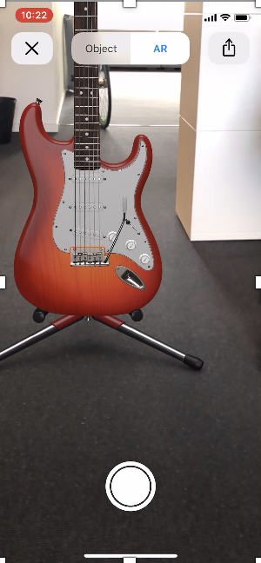
APPLE QUICK-LOOK
USDZ-FORMAT
Source: Apple/Saint Elmo‘s Berlin
Notes:
ARKit includes a built-in viewer for displaying and sharing high-quality 3D content using Pixar's usdz file format to deliver content for viewing across Safari, Mail, Messages, and other built-in applications.

Slide 63
WEB-AR
Notes:
WebAR shows us, it’s not necessary to download a third party applications.

Slide 64
WEB-AR NO APPLICATIONS
Notes:
That a common user will surely uninstall soon after, or that probably they won’t download at all.

Slide 65
WEB-AR NO APPLICATIONS FOR ANYONE
Notes:
Delivering augmented reality on the web, you make it easily suitable for everyone.

Slide 66
WEB-AR NO APPLICATIONS FOR ANYONE FRICTIONLESS
Notes:
Web-AR reduces the steps to start an experience – it’s frictionless
(no need to point users to the app store, then install an app, then open the app and rescan the trigger)

Slide 67
WEB-AR NO APPLICATIONS FOR ANYONE FRICTIONLESS eASY
Notes:
All you need to do is to scan a QR-code, open the link in your mobile browser and enjoy the experience!

Slide 68
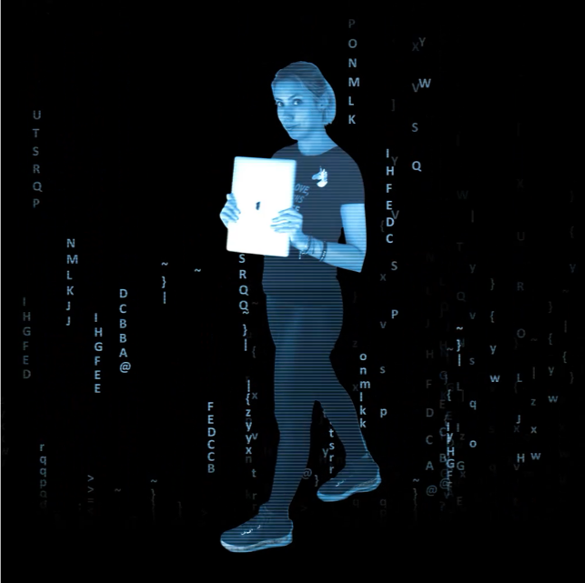


CONTACT ME: ANASTASIIA MIROSHNICHENKO
WEB XR DEVELOPER
a.miroshnichenko@saint-elmos.com
@AnastasiiaaaaM
THANK YOU!
The content of this presentation is proprietary and confidential information of Saint Elmo’s Berlin GmbH & Co. KG. The document and the information in it are provided in confidence, for the sole purpose of exploring business opportunities between the disclosing party and the receiving party and may not be disclosed to any third party or used for any other purpose without the express written permission of the disclosing party.

Slide 69

Notes:
You can try it by yourself!

